Slide 1
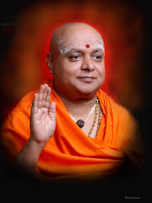

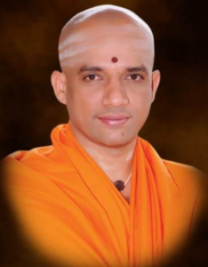

BGS POLYTECHNIC
CHICKBALLAPURA
TEAM MEMBER:
NAVANEETH. M (498CS22046)
PAVANRAJ. V (498CS22051)
PAVAN. S (498CS22052)
HARISH. N (498CS22029)

Slide 2
Video Surveillance System with Motion Detection
Final Capstone Project Presentation
Team: Mike
Department of Computer Science & Engineering
2025

Slide 3
Introduction
Objective – Develop a real-time motion detection system with video
processing and visualization.
Key Features – Motion detection, video recording, snapshot capture, and
graphical motion intensity representation.
Application – Enhances security, surveillance, and automated monitoring
systems.

Slide 4
Objectives
Detect motion: Detect motion in video footage from cameras.
Record video footage: Record video footage from cameras.
Provide real-time monitoring: Provide real-time monitoring of video footage.

Slide 5
Literature Survey
• Compared traditional CCTV and modern AI-based systems.
• Evaluated OpenCV and alternative libraries.
• Studied past failures due to false alarms and poor integration.

Slide 6
Methodology
1. Capture live video using a webcam/IP camera.
2. Analyze frame differences using OpenCV.
3. Trigger alerts and store evidence if motion is detected.
4. Display data via web-based interface.

Slide 7
Problem Identification
• Manual surveillance is resource-heavy and error-prone.
• Existing solutions lack real-time processing.
• High cost and poor integration limit current systems.

Slide 8
Deliverables
Software application: A software application that captures and records video footage from cameras, detects motion, and alerts users of potential security threats.
User manual: A user manual that provides instructions on how to use the software application.
Technical documentation: Technical documentation that provides information on the software application's architecture, design, and implementation.

Slide 9
System Description
A Video Surveillance System with Motion Detection is a software application that
captures and records video footage from cameras, detects motion, and alerts users of potential security threats
Real-time motion tracking from live video.
Backend in Python using Flask and OpenCV.
Events are logged and available for review.

Slide 10
Key Milestones
• Week 1–2: Planning and Literature Review
• Week 3–4: Frontend and Interface Design
• Week 5–6: Backend with Motion Detection
• Week 7–10: Testing and Optimization
• Week 11–14: Documentation and Submission

Slide 11
Cost Breakdown
Camera Module: ₹1,500
Hosting/Tools: ₹500
Miscellaneous: ₹500
Total Estimated Cost: ₹2,500

Slide 12
Timeline Schedule
• Total Duration: 14 weeks
• Aligned with academic milestones
• Weekly goals with internal evaluations and final demo

Slide 13
Risk Analysis
• Risk: False Alerts → Solution: Tune thresholds
• Risk: Hardware Failure → Solution: Backup devices
• Risk: Time Constraints → Solution: Early planning

Slide 14
Testing Phases
• Unit Testing: Individual components
• Integration Testing: Combined modules
• System Testing: Complete functionality
• User Testing: Peer and mentor validation

Slide 15
Results
• Successfully detected motion in real-time
• Alerts triggered accurately with low false positives
• Integrated user-friendly interface and database

Slide 16
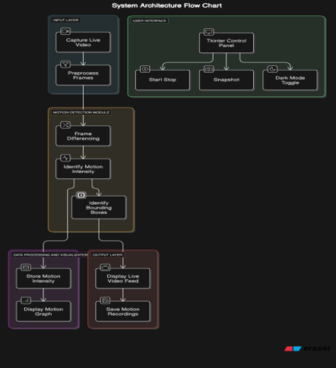
System Architecture

Slide 17
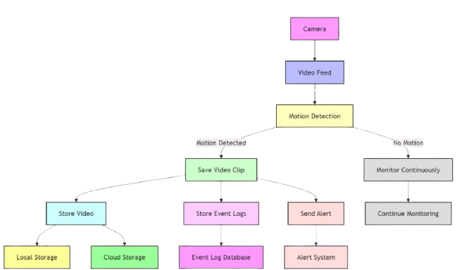
Dataflow Diagram

Slide 18
Conclusion
• Automated surveillance system implemented successfully.
• Practical application with future scope: cloud alerts, face detection.
• Gained experience in system integration, testing, and UI/UX design.

